Slide 1
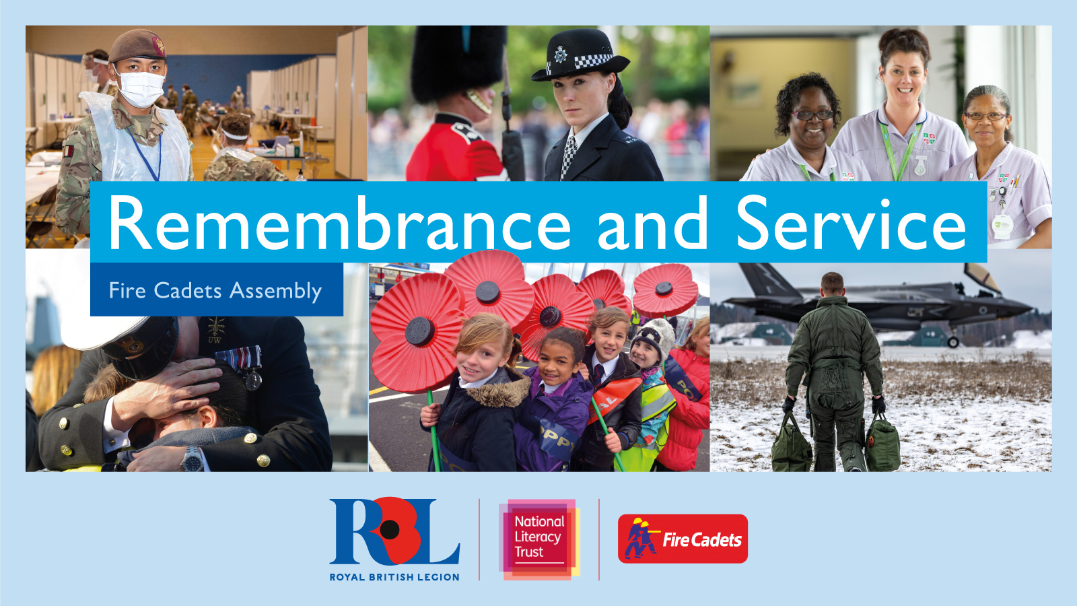

Slide 2
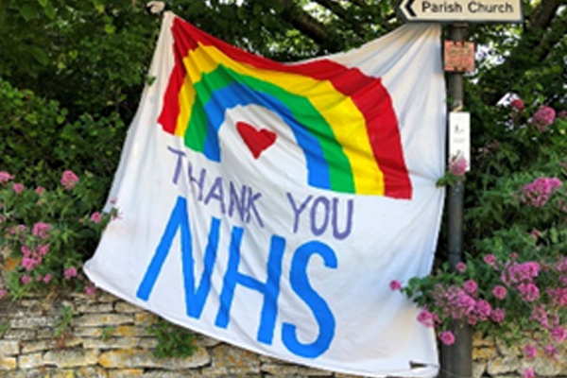
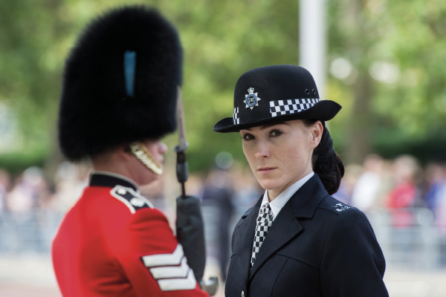
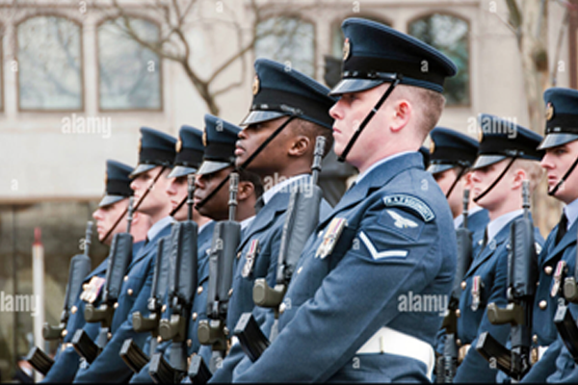
What is Service?
Notes:
Invite cadets to look at the photographs and respond to the following questions:
Q: Ask cadets how do they think these people are serving/helping to protect others? Responses may include keeping people safe; fighting for freedom in conflicts; community support
Q: Ask cadets what examples of service can they see?
Q: Ask cadets who are they serving or protecting? Responses may include people, the community, the country
Q: What do they feel when seeing images like this, about their own role as cadets?

Slide 3
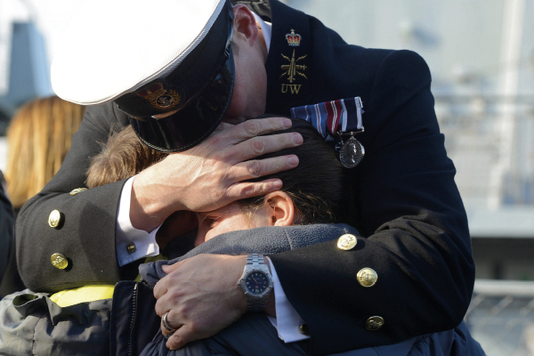
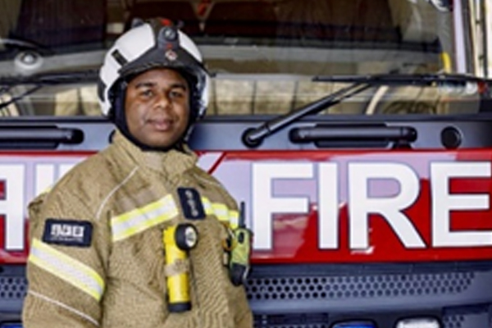
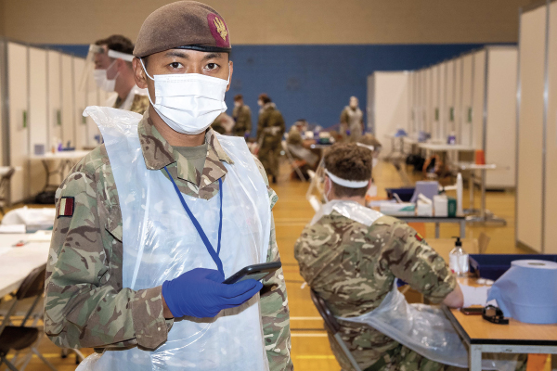
How would you define service?
Glossary
Service: The act of defending/protecting the nation’s democratic freedoms and way of life
Notes:
Reflecting on the previous discussion and the images on the slide, ask the cadets how would they describe service to someone not in service? Give the cadets time to talk to in pairs/small groups to formulate their ideas and then take some suggestions.
Share the Royal British Legion’s definition of service – and click to bring the definition onto the slide/
The act of defending/protecting the nation’s democratic freedoms and way of life. Service can come in many forms; the role of the civilian emergency services, the role of the intelligence services, and the service provided by those in the Armed Forces. It can also include the role of civilians during times of conflict or national emergency, for example the Women’s Land Army who helped feed the nation during the First and Second World Wars, or the thousands of volunteers that have supported the NHS during the Covid pandemic.
This type of service will usually be given at great risk to the individual or in support of members of the public or the nation who are at risk. This service can be either paid or voluntary and can be given at an individual’s choosing or at the behest of the government of the country.

Slide 4
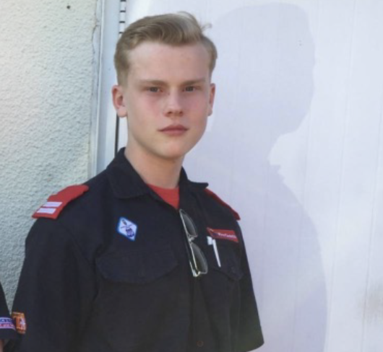
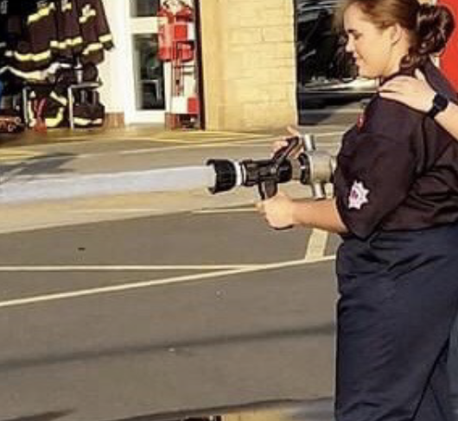
What is service?
Jessey Wooding
Red Cross Fire Emergency Support Service
2020–present
Trainee Firefighter, Leicestershire Fire & Rescue Service 2022–present
Amber Matthews
Former Fire Cadet, Wincanton
Devon and Somerset Fire and Rescue Service
2016–2021
Notes:
Invite cadets to look at the people in the images and think about how they might have served others.
Now introduce the people in the images to the cadets:
Jessey Wooding, Former Fire Cadet, Western Fire Cadets, Leicester 2014–2020; Red Cross Fire Emergency Support Service 2020–present; Trainee Firefighter, Leicestershire Fire and Rescue Service 2022–present. Jessey has always wanted to be a firefighter and remembers how, when he was younger, he would watch the fire engines go out from the local fire station. When he was 18, he volunteered for the Red Cross Fire Emergency Support Service (FESS) and is now a trainee firefighter.
Amber Matthews, Former Fire Cadet, Wincanton, Devon and Somerset Fire and Rescue Service, 2016–2021. Amber joined the fire cadets as an extra-curricular activity, but she soon found that it built up her confidence and offered her the opportunity to learn different ways in which she could help others. She used her skills to volunteer in various ways during the pandemic, and since aging out of fire cadets, Amber now works for the NHS as a ‘Health and Wellbeing Coach’ at her local GP practice. When she is not at work, Amber is back at the fire station helping to train current cadets.
Q: Ask cadets if having this information changes how they think about the service these people have given. If so, how and why?
Take it further activity: Cadet Skills
Invite cadets to reflect on the examples above, where each person shows and develops different skills.
Ask the cadets, in pairs, to think about what new skills they have tried. Ask them to imagine that they are giving a speech about the benefits of being a cadet. What skills have they learnt so far, and why they are valuable? How do their skills help them serve others, and what could they pass on to others? How would they use this to encourage others to serve in the cadets? Invite them to present their ideas back to their peers.
NEW cadets this time of year – skills so far, excited to learn, hoping to learn?

Slide 5
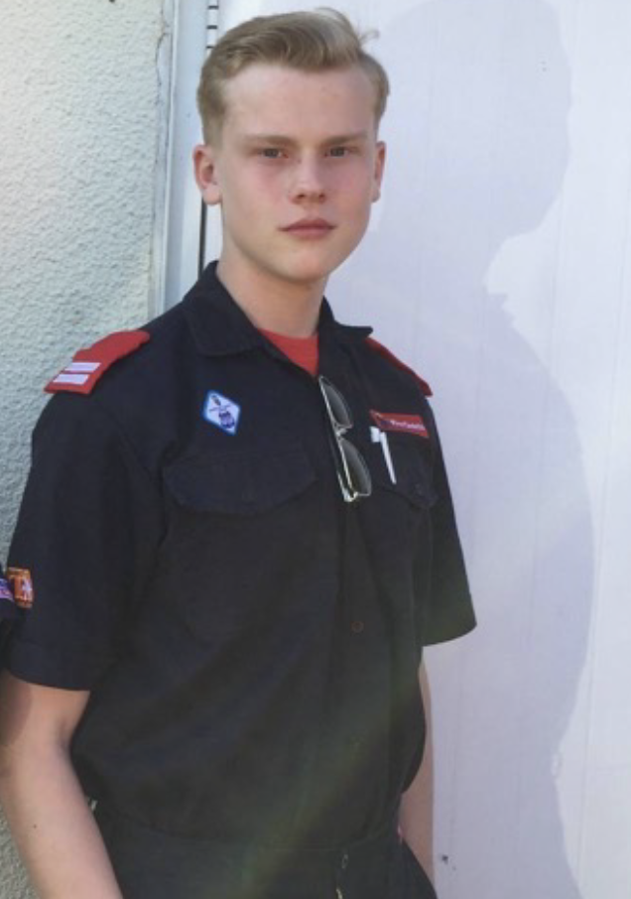
What is service?
Jessey Wooding
Jessey joined the Cadets in 2014 and has particularly enjoyed learning about how to use breathing apparatus.
At 18, he volunteered for the Red Cross Fire Emergency Support Service (FESS).
Whilst volunteering with the FESS, Jessey has helped provide support for the homeless, refugees.
In 2022, Jessey began his training with the Leicestershire Fire and Rescue Service.
In what ways has Jessey served others?
Notes:
Jessey says:
“I always thought being a firefighter, it’s just going out, putting out fires. Coming back, putting out more fires. But as soon as I joined cadets, I learned it was a misconception and that there was so much more…. I think it’s brought me totally out of my shell as a person. Just being older, you see yourself in the younger cadets. Same attitude, same low confidence, quiet, speaking only when spoken to. Whereas now, as the months go on and over the years, much more vocal and out there, willing to suggest ideas and get involved.”
Q: How has Jessey served his community through these activities? Draw out that Jessey has learnt many new skills and applied these to serving others, including volunteering for the FESS in addition to cadets and training to be a firefighter. His experiences have been wide-ranging, and he has supported many different people in difficult situations.

Slide 6
What is service?
“We provide emotional support, as well as physical. Basically, making sure that in their worst time, they’re not having to think of anything except the incident itself and actually getting over it.”
Jessey Wooding
Notes:
When Jessey was 18, he volunteered for the FESS. The Fire Service can contact the FESS if, for example, someone has had a house fire, if their house has been flooded, if there’s been a gas explosion or if their house is classified as uninhabitable.
Q: Ask cadets how Jessey’s experiences make them think about the idea of serving? Do they feel any differently now that they know more about what he has done? Draw out that understanding what people have done can help us appreciate their service even more. This is why Remembrance is so important, as it reminds of the Service and sacrifice given by many. For cadets, Jessey’s story is a reminder of the value of the skills they are learning, no matter what career path they decide to follow, of how they can contribute to their communities through service and of how they all have something they can offer. It also shows the wide variety of ways cadets can get involved and that serving as a firefighter is more than just putting out fires. Jessey shows real commitment volunteering for the FESS in addition to his day job.
Take it further activity: Action and impact
After considering Jessey’s experiences, which range from fire-fighting to supporting those affected by fire-related or humanitarian disasters, invite cadets to consider:
What can they learn from Jessey’s example of Service?
How could they remember Jessey’s service during this coming Remembrancetide?
What impact can serving have on others?
To help cadets understand the impact serving can have, invite them (in pairs or independently) to create a table to show the actions taken and the impact they would have had. This can be from the cadet’s own experiences or things they have observed in their communities or even nationally.
ACTION
Example: Helping refugees, providing medical and emotional support
IMPACT
Life-saving, helping families who have had to leave their homes

Slide 7
What does service mean for those serving?
“I felt like I didn’t want to come away. Although I felt physically and mentally exhausted, I felt that if I was not there, that’s one less person to help them and give them support.”
Jessey Wooding
Notes:
Whilst volunteering with the FESS, Jessey has helped provide support for the homeless, refugees and victims of human-trafficking. In August 2021, approximately 15,000 Afghan refugees were brought to the UK, many of whom arrived at Birmingham International Airport where Jessey and other Red Cross volunteers were despatched to help them. One particular experience has made a lasting impression on Jessey. It involved a three year old boy who collapsed in his arms.
Read out at discretion
“All his mum could say was ‘He is three years old and he’s got chest pains’. And not having full training – I’d only been able to do partial training – and with the language barrier, it felt like an eternity waiting for help for the kid, reassuring the mother that help was on the way. It transpired that he did have a heart condition, and with him not eating or drinking for the duration of the journey, and the stress of what was going on, it triggered a worsening of his heart defect”.
Q: Ask cadets to consider what they think has motivated Jessey to serve. What can we learn from his example? What sacrifices has Jessey made as he serves his community? Encourage cadets to consider that Jessey has sacrificed his time and energy, as well as his mental health and wellbeing, in order to help others. His attitude to service has been one of recognising the good he can do and the importance of supporting people in need.
Invite cadets to consider what sacrifices they might make as they serve.
Build towards an understanding that:
For RBL sacrifice comes in many forms, it can be the sacrifice of time with family when, for example, a member of the Armed Forces is sent to serve overseas or a nurse in the NHS cannot see her family because she is on the frontline fighting Covid. It can also mean the sacrifices made physical and mentally as a result of service, or it can mean the ultimate sacrifice made while serving. In each case the sacrifice is made while serving to protect the nation’s democratic freedoms or way of life.
Take it further activity: Serving the community
Invite cadets to think about their own communities. Can they identify anyone who might need help? What help and support could they offer? Challenge cadets, in pairs, to come up with a community service idea that will help serve and address a specific need in their community or give opportunities to others that they may not get otherwise. Remind them to think about:
Who they want to help.
How they are going to help them.
What the benefit will be to everyone involved.
What sacrifices cadets might have to make to ensure the idea is successful.
Invite them to share their ideas in a presentation. The class could vote for the winning idea and then put it into practice.

Slide 8
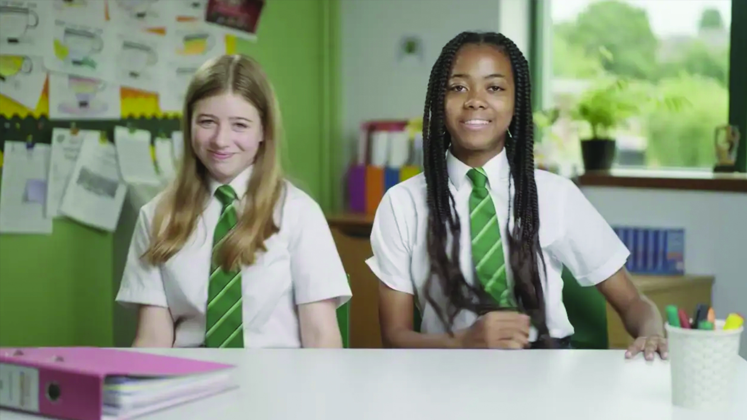
Why do we remember service?
Notes:
Q: Reflecting on the previous slides and the video they have just seen, ask the cadets what they have learned about service, and why we remember service.
The Royal British Legion describes that we remember as a way of honouring, as well as it being a way of thanking and acknowledging, the service and sacrifice of millions of men and women from Britain and the Commonwealth who serve, or have served, to defend our democratic freedoms and way of life.
Who do we Remember? We remember the sacrifice of the Armed Forces community from Britain and the Commonwealth.
We pay tribute to the special contribution of families and of the emergency services.
We acknowledge innocent civilians who have lost their lives in conflict and acts of terrorism.
Invite cadets to share about anyone they will specifically be remembering during this time, who served and sacrificed or who is serving today. Some cadets may have experience of parents or carers or other family members who serve(d) in the Armed Forces or emergency services, or on the frontline during the pandemic.

Slide 9
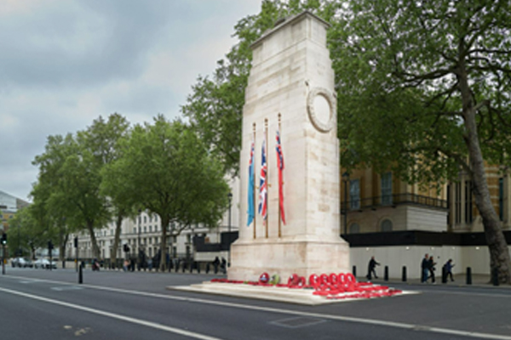
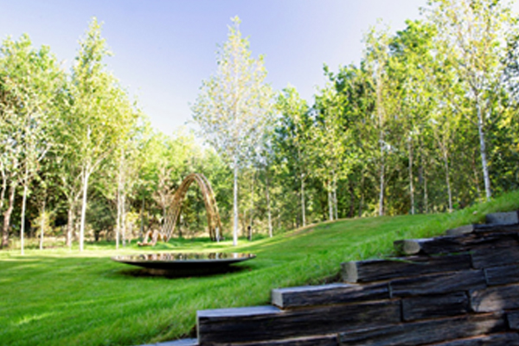

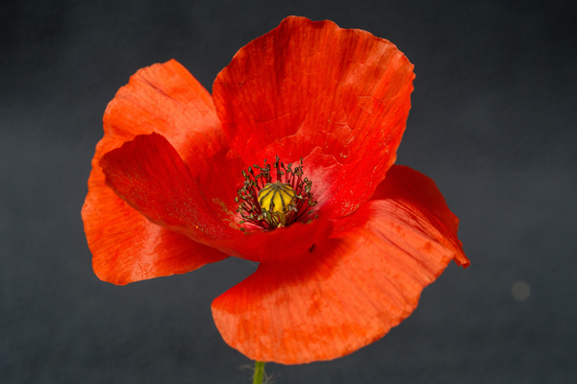
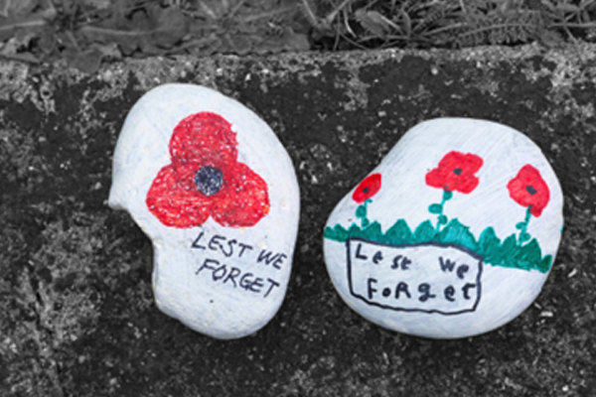
What is Remembrance?
Notes:
Thinking about what they have learnt and their own experiences, encourage cadets to consider what Remembrance means to them.
Q : Invite cadets to think about what they have learnt about service and sacrifice. Keeping this in mind, what does Remembrance mean to them? (Cadets will have varying degrees of pre-existing understanding about Remembrance and experience of it; encourage them to share their ideas and anything new they have learnt or felt today; Remembrance is personal as well as a shared experience and it is important to value the various ideas people have of it)
The Royal British Legion defines Remembrance an act honouring those who serve, or have served, to defend our democratic freedoms and way of life.
Remembrance is not a commemoration of wars or conflicts; it is about the service and sacrifice of individuals or communities.
Service and sacrifice takes place both within and outside of conflict, for example the service performed by the army in fighting Covid or by the navy in providing disaster relief to British Overseas Territories.
We do not remember just service given during war or conflict.
How do we Remember?
While there are two national days dedicated to Remembrance, Armistice Day on the 11th November and Remembrance Sunday which takes place on the second Sunday in November, how an individual chooses to remember is a personal choice. The Royal British Legion does not prescribe how people should remember but asks that any Remembrance activities are inclusive of all members of the community.
Invite cadets to share any experiences they have of participating in Remembrance services or events.
The Poppy
The red poppy is both the national symbol of Remembrance and also a representation of a hope for a peaceful future. There is no right way to wear a poppy and wearing one is never compulsory but is greatly appreciated by those who it is intended to support.
Invite cadets to consider what they will think about next time they wear or see a Poppy.
The Act of Remembrance
The Act of Remembrance is a brief and non-religious act and includes the reading of the reading of the Exhortation and the Kohima Epitaph, and a two-minute silence. Readings, music or other elements can be added to it to personalise it or make it more relevant to a particular community. The details of the Act can be found here https://www.britishlegion.org.uk/get-involved/remembrance/about-remembrance/act-of-remembrance along with a sound file for the Last Post and two-minute silence.

Slide 10
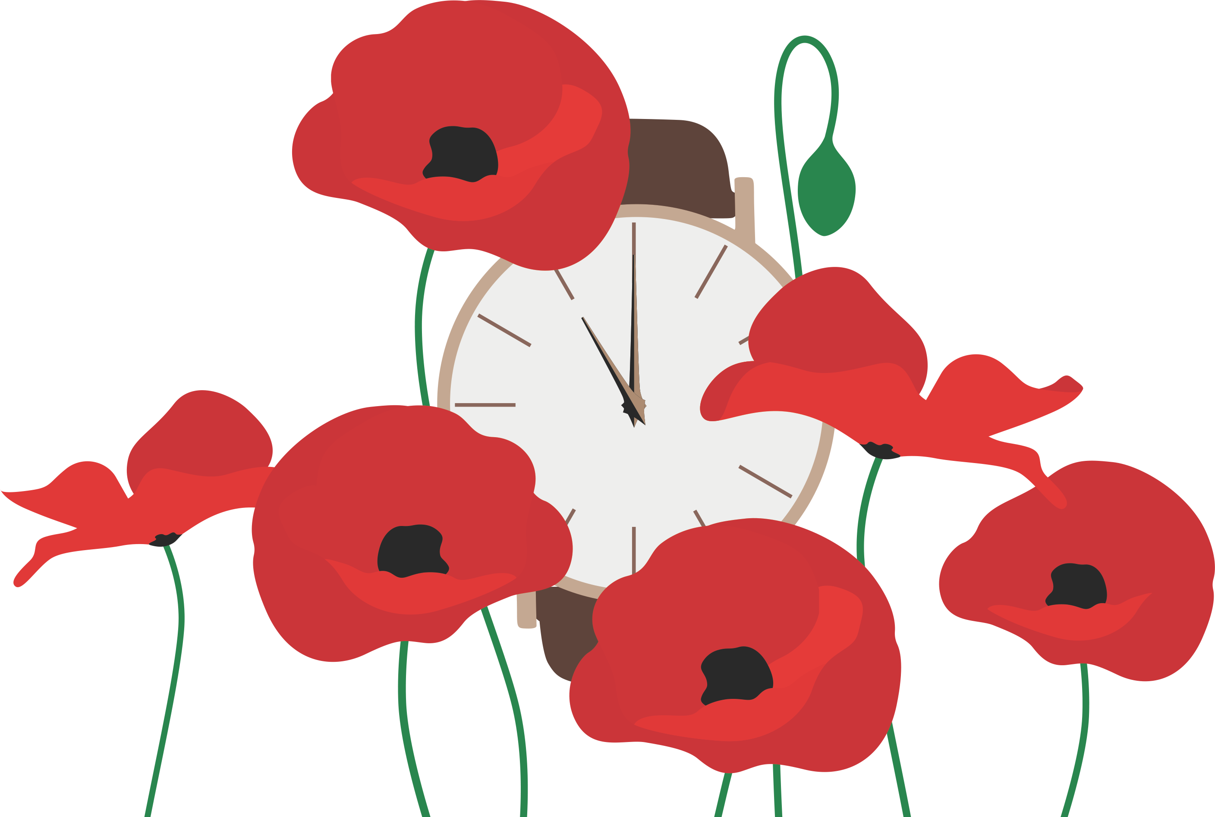
Focus on Remembrance
Notes:
Invite cadets to hold a one minute silence in Remembrance of who gave, and continue to give, in service and sacrifice.

Slide 11

Take action
What can we do in our communities to support Remembrance and uphold the values of those who have served and sacrificed?
How can cadets apply their learning today to their own service?
Notes:
Questions to consider:
How can cadets bring their learning from the assembly into their every day service?
How does learning about fellow cadets inspire them?
What will their next steps be?
How will they mark Remembrance this year?

Slide 12
Registered address: Royal British Legion, Haig House, 99 Borough High Street, London SE AA
Registered charity number: 29279

